Slide 1
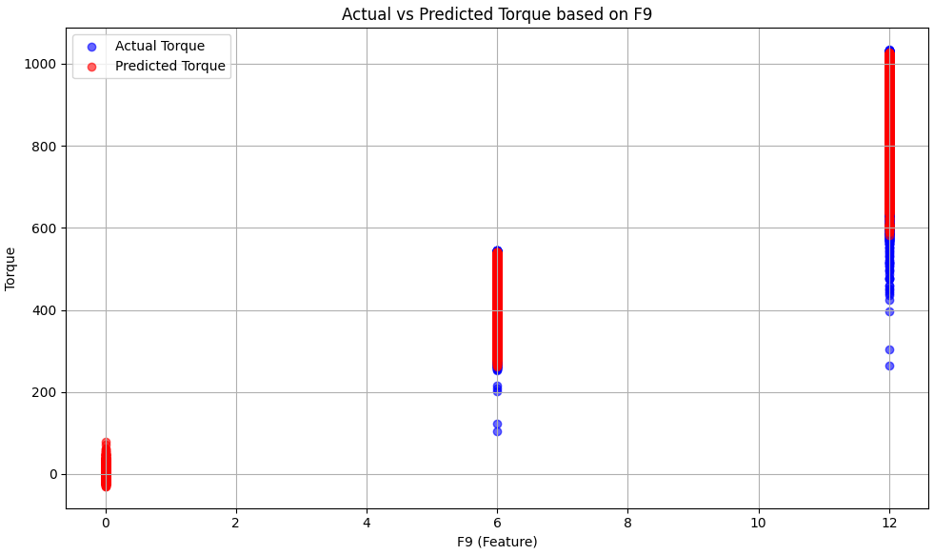
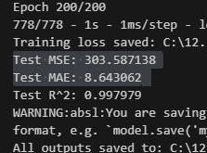

Slide 2
Test 2 - RandomForest, HistGBR,MLP

Slide 3
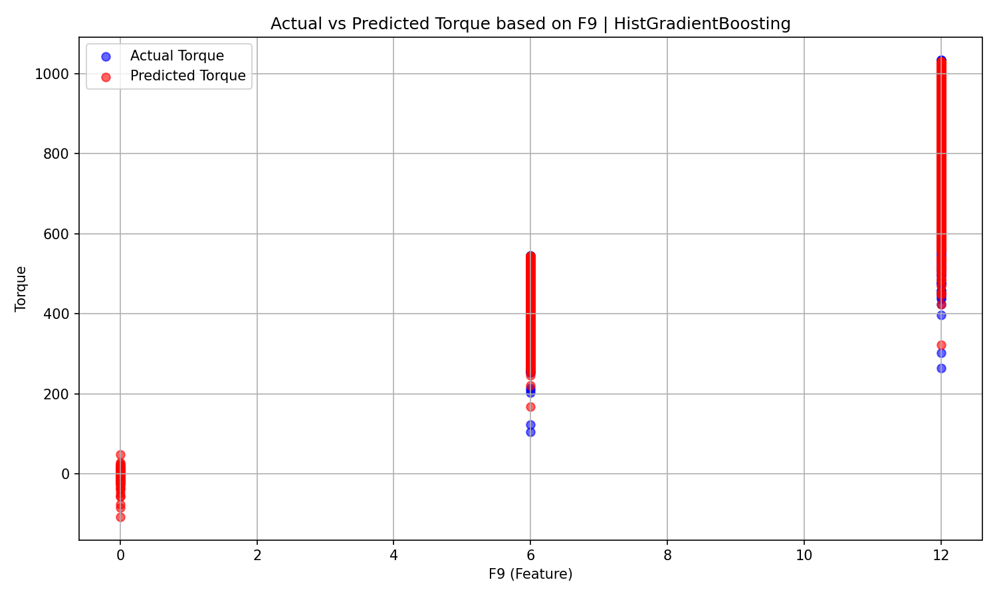

Slide 4
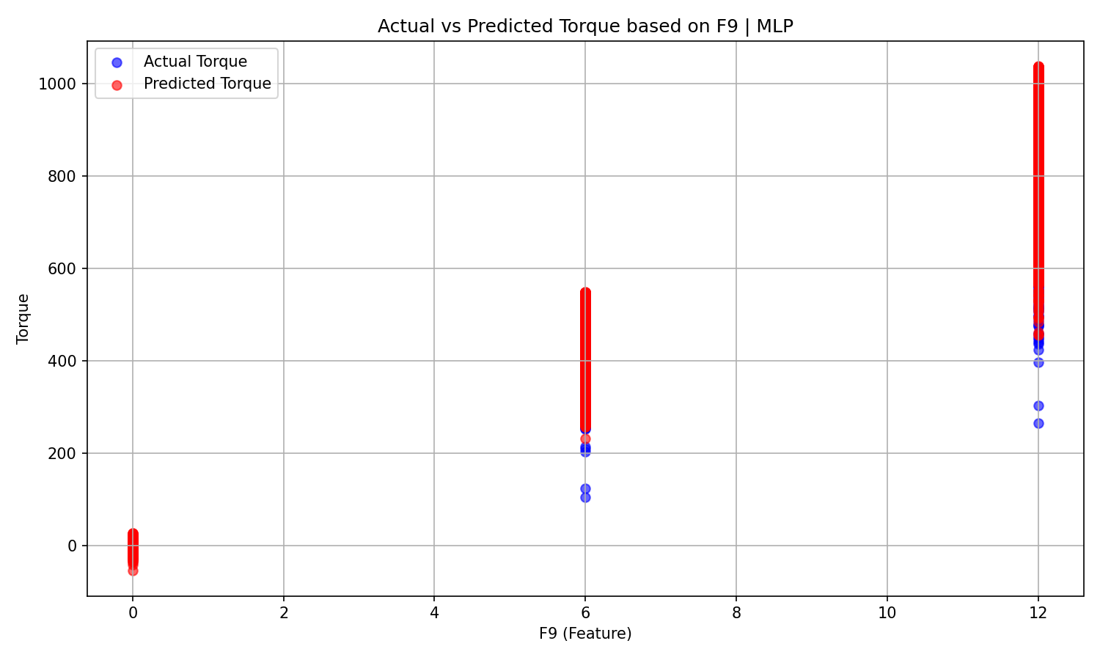

Slide 5
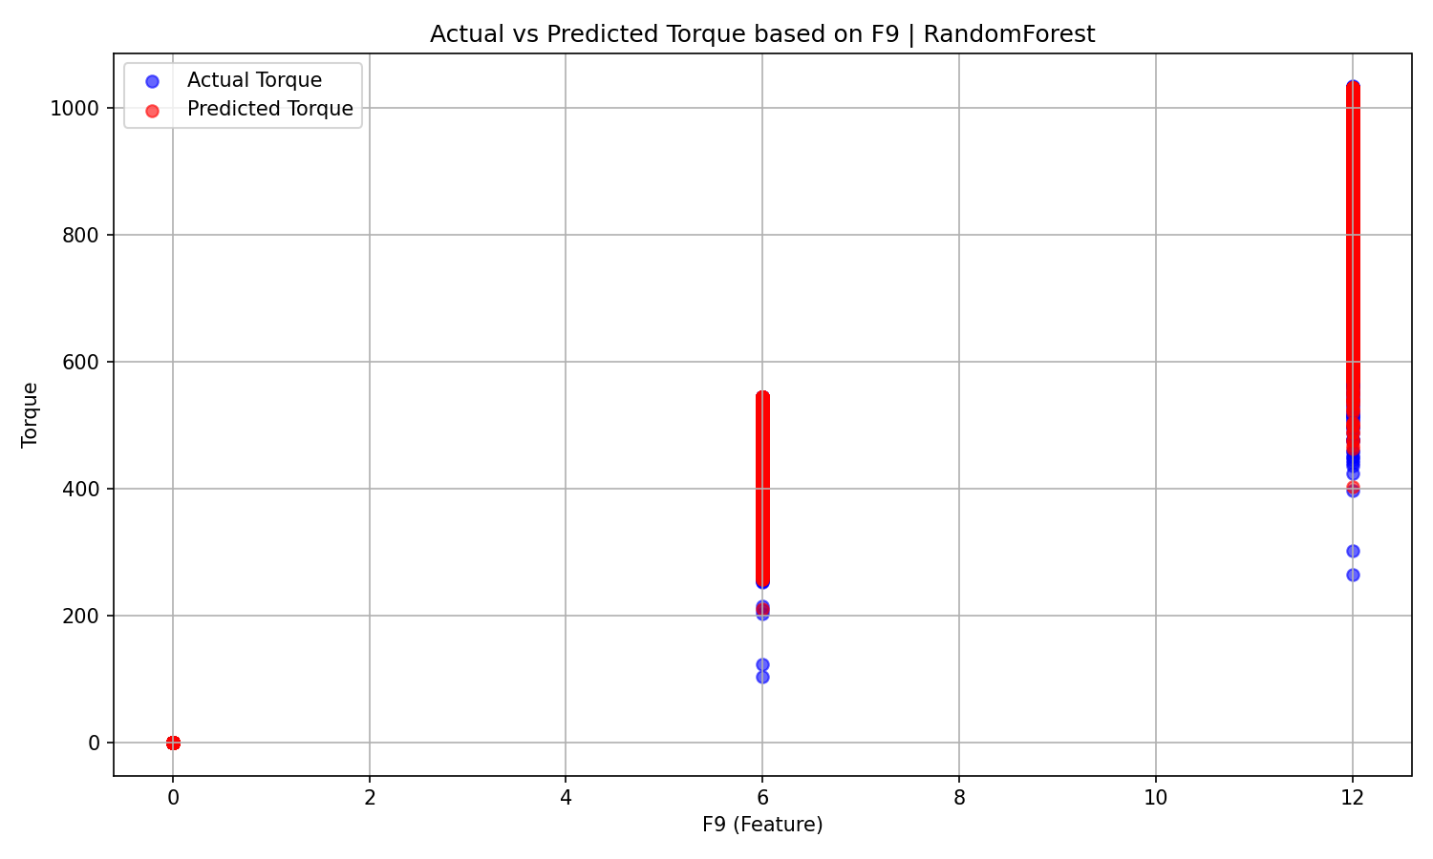


Slide 6
Test 3 – HistGBR + optuna

Slide 7
